Slide 1
Architectural Project
Matthew Ernst
METC 107

Slide 2
My Home Layout
The house will be about 1500 sq. ft. of total area; small and basic
Usually houses 1-5 people
There are 11 rooms to this house:
  One family room
  One living room
  One kitchen
  One laundry room
  One dining room
  Three bedrooms
  Two bathrooms
  A garage

Slide 3
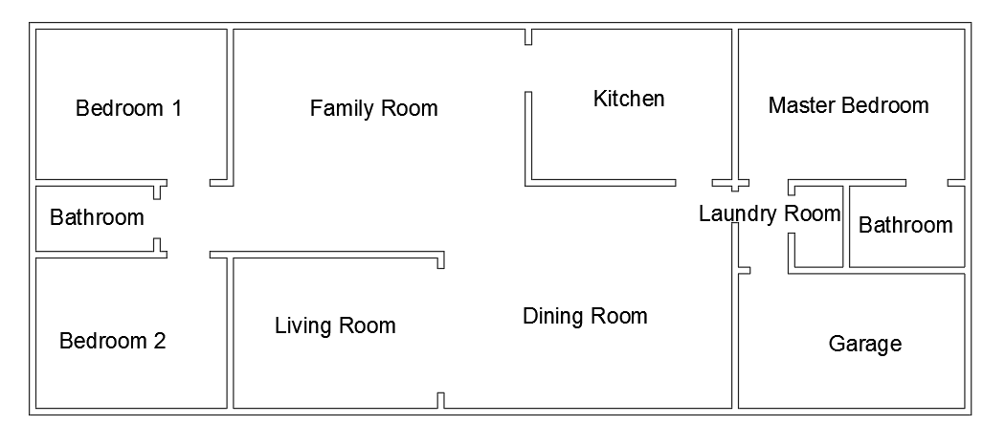
AutoCAD drawings of the house w/out dimensions

Slide 4
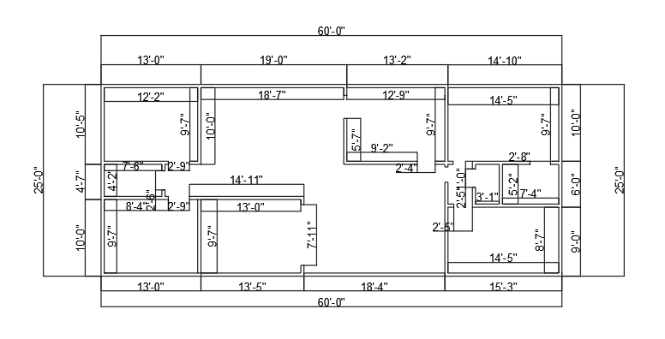
AutoCAD Drawings of the House with Dimensions

Slide 5
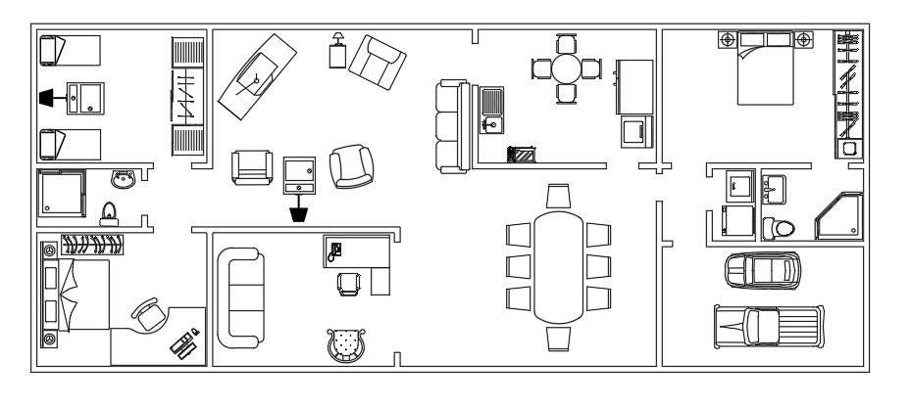
AutoCAD Drawings of the House with Furniture

Slide 6
How much the home would cost
It costs about $95 for one square foot
1500 sq. ft. x $95 per sq. ft. = $142500
$500 per couch, 2 couches = $1000
$250 per chair, 5 chairs = $1250
$700 king size bed, $500 queen size, 2 $200 single beds = $1600
$50 per table, 5 tables = $250
Dining room set = $2000
Refrigerator = $1000
Washer and dryer = $1500
Kitchen table = $500
TV = $750 TOTAL = $152350

Slide 7
Neat aspects of my House
Very simple, small
Easy to maintain
Efficient – Water Heater and HVAC systems

Slide 8
Disadvantages of my House
Not very big; no upper floor
Cannot accommodate big gatherings
Not all kids and grandkids can stay simultaneously

Slide 9
How I made the drawings
I used cad-blocks.net as my only source for this project
My grandparents helped me estimate the prices of the house

